Slide 1
Dashboard Report - Sales & Profit Overview
Data Analyst Internship - Task 4: Dashboard Design
Synthetic Superstore Dataset

Slide 2
Key Performance Indicators (KPIs)
Total Sales: $1,868,881
Total Profit: $265,839
Orders: 2000
Average Order Value: $934.44
Latest YoY Sales Growth: 3.84%

Slide 3
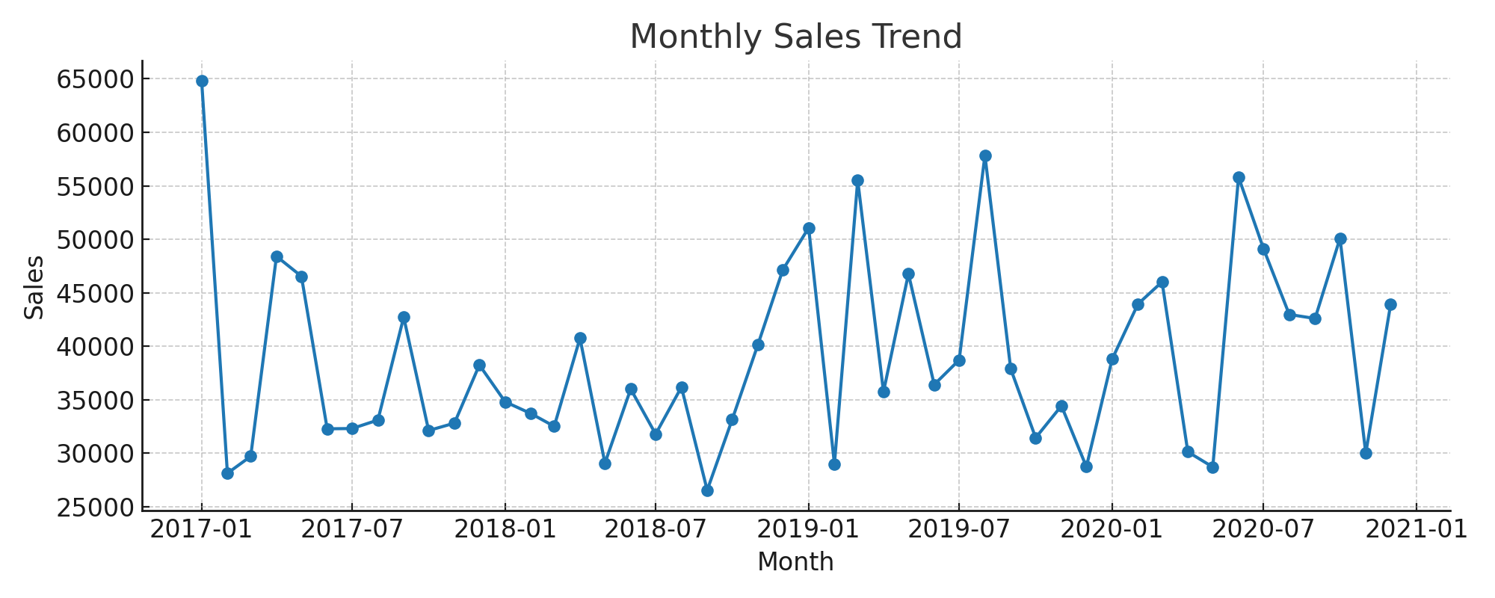
Monthly Sales Trend

Slide 4
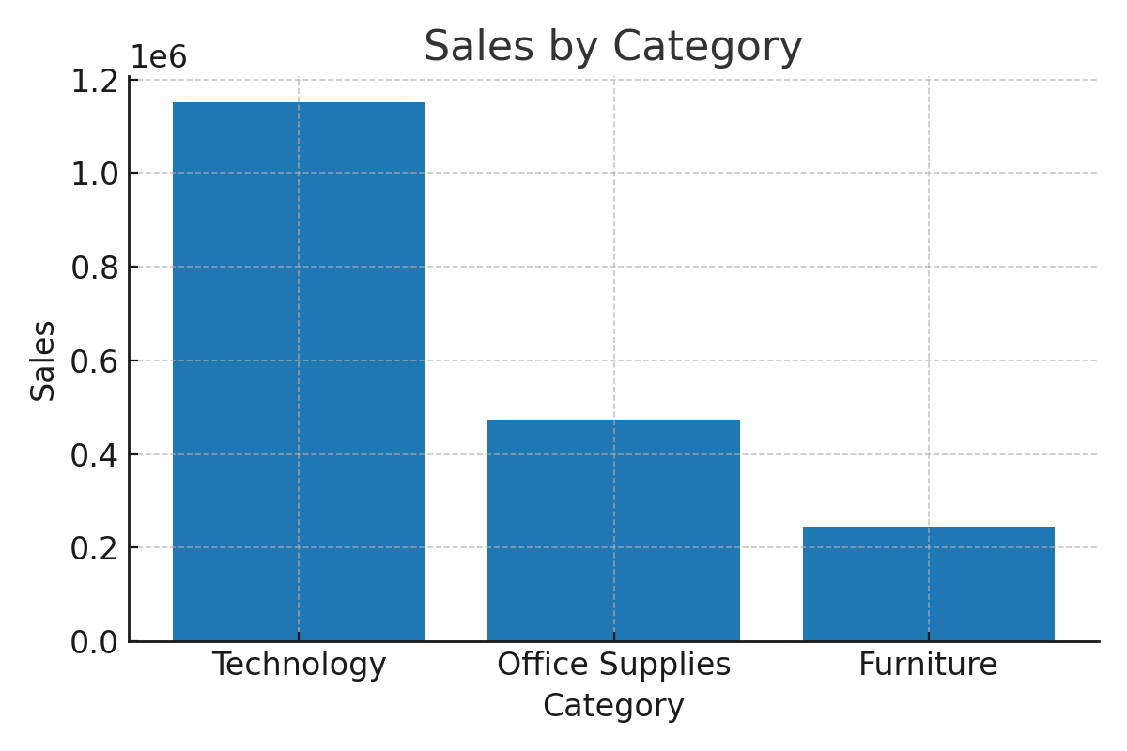
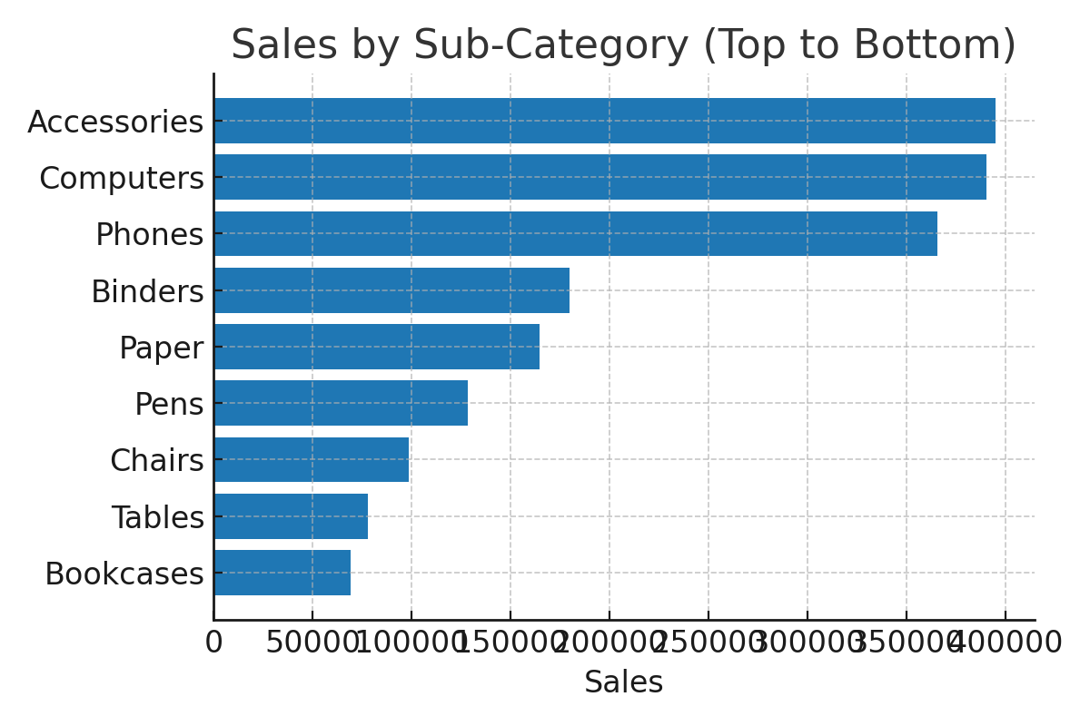
Category & Sub-Category Breakdown

Slide 5
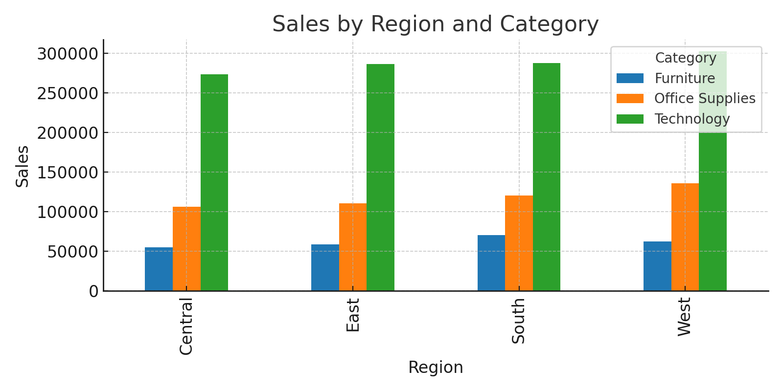
Sales by Region & Category

Slide 6
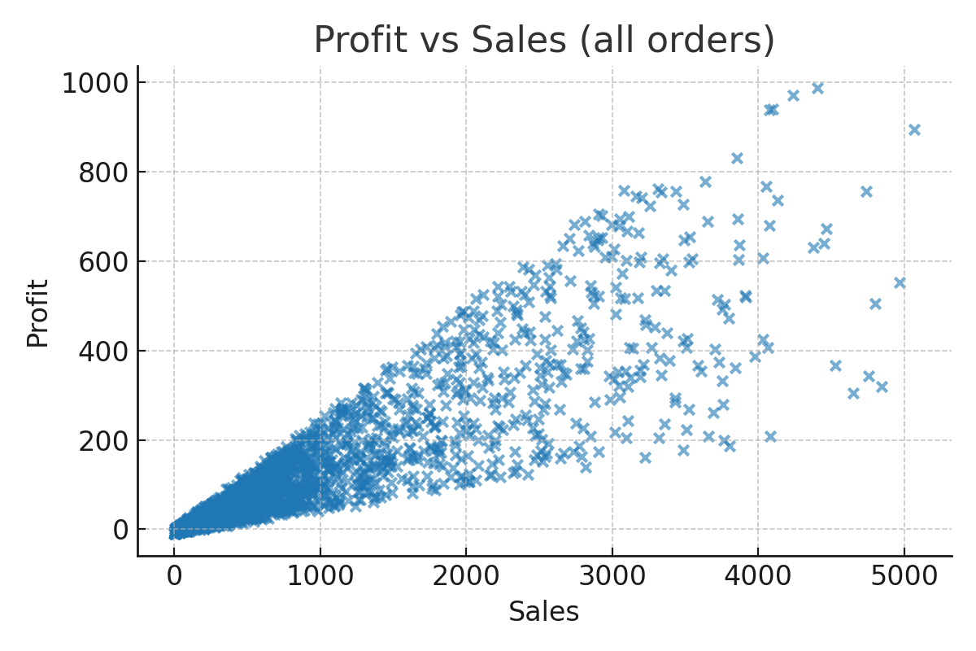
Profitability & Correlations

Slide 7
Summary & Recommendations
Objective:
Provide stakeholders with quick insights into Sales, Profit, and Growth.
Key Components: KPIs, Time-series trends, Category breakdown, Regional split, Profitability chart.
Interactivity: Slicers for Year, Region, Category; Bookmarks; Tooltips for details.
Recommendations: Improve margins for low-profit high-sales sub-categories; Investigate declining regions; Use filters for ad-hoc questions.

